Slide 1
Programming with OpenGL Part 3: Three Dimensions
Ed Angel
Professor of Computer Science, Electrical and Computer Engineering, and Media Arts
University of New Mexico

Slide 2
Objectives
Develop a more sophisticated three-dimensional example
Sierpinski gasket: a fractal
Introduce hidden-surface removal

Slide 3
Three-dimensional Applications
In OpenGL, two-dimensional applications are a special case of three-dimensional graphics
Going to 3D
Not much changes
Use glVertex3*( )
Have to worry about the order in which polygons are drawn or use hidden-surface removal
Polygons should be simple, convex, flat

Slide 4
Sierpinski Gasket (2D)
Start with a triangle
Connect bisectors of sides and remove central triangle
Repeat

Slide 5
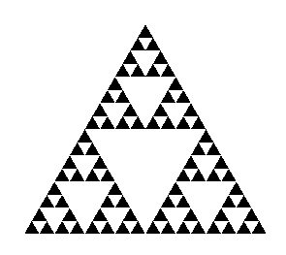
Example
Five subdivisions

Slide 6
The gasket as a fractal
Consider the filled area (black) and the perimeter (the length of all the lines around the filled triangles)
As we continue subdividing
the area goes to zero
but the perimeter goes to infinity
This is not an ordinary geometric object
It is neither two- nor three-dimensional
It is a fractal (fractional dimension) object

Slide 7
Gasket Program
#include <GL/glut.h>
/* initial triangle */
GLfloat v[3][2]={{-1.0, -0.58},
{1.0, -0.58}, {0.0, 1.15}};
int n; /* number of recursive steps */

Slide 8
Draw one triangle
void triangle( GLfloat *a, GLfloat *b, GLfloat *c)
/* display one triangle */
{
glVertex2fv(a);
glVertex2fv(b);
glVertex2fv(c);
}

Slide 9
Triangle Subdivision – Recursive Program Draw the recursion tree (what order is it)
void divide_triangle(GLfloat *a, GLfloat *b, GLfloat *c, int m)
{
/* triangle subdivision using vertex numbers */
point2 v0, v1, v2;
int j;
if(m>0)
{
for(j=0; j<2; j++) v0[j]=(a[j]+b[j])/2;
for(j=0; j<2; j++) v1[j]=(a[j]+c[j])/2;
for(j=0; j<2; j++) v2[j]=(b[j]+c[j])/2;
divide_triangle(a, v0, v1, m-1);
divide_triangle(c, v1, v2, m-1);
divide_triangle(b, v2, v0, m-1);
}
else(triangle(a,b,c));
/* draw triangle at end of recursion */
}

Slide 10
display and init Functions
void display()
{
glClear(GL_COLOR_BUFFER_BIT);
glBegin(GL_TRIANGLES);
divide_triangle(v[0], v[1], v[2], n);
glEnd();
glFlush();
}
void myinit()
{
glMatrixMode(GL_PROJECTION); // set the view volume
glLoadIdentity(); //initialize
glOrtho(-2.0, 2.0, -2.0, 2.0,-1.0, 1.0 ); //DT changed to glOrtho()
glMatrixMode(GL_MODELVIEW); //set the Mdelview volume
glLoadIdentity();
glClearColor (1.0, 1.0, 1.0,1.0)
glColor3f(0.0,0.0,0.0);
}

Slide 11
main Function
int main(int argc, char **argv)
{
n=4;
glutInit(&argc, argv);
glutInitDisplayMode(GLUT_SINGLE|GLUT_RGB);
glutInitWindowSize(500, 500);
glutCreateWindow(“2D Gasket");
glutDisplayFunc(display);
myinit();
glutMainLoop();
}

Slide 12
Efficiency Note
By having the glBegin and glEnd in the display callback rather than in the function triangle and using GL_TRIANGLES rather than GL_POLYGON in glBegin, we call glBegin and glEnd only once for the entire gasket rather than once for each triangle

Slide 13
Moving to 3D
We can easily make the program three-dimensional by using
GLfloat v[3][3]
glVertex3f
glOrtho
But that would not be very interesting
Instead, we can start with a tetrahedron

Slide 14
3D Gasket
We can subdivide each of the four faces
Appears as if we remove a solid tetrahedron from the center leaving four smaller tetrahedra

Slide 15
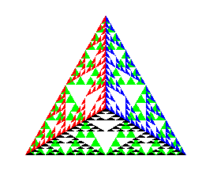
Example
after 5 iterations

Slide 16
triangle code
void triangle( GLfloat *a, GLfloat *b, GLfloat *c)
{
glVertex3fv(a);
glVertex3fv(b);
glVertex3fv(c);
}

Slide 17
subdivision code
void divide_triangle(GLfloat *a, GLfloat *b, GLfloat *c, int m)
{
GLfloat v1[3], v2[3], v3[3];
int j;
if(m>0)
{
for(j=0; j<3; j++) v1[j]=(a[j]+b[j])/2;
for(j=0; j<3; j++) v2[j]=(a[j]+c[j])/2;
for(j=0; j<3; j++) v3[j]=(b[j]+c[j])/2;
divide_triangle(a, v1, v2, m-1);
divide_triangle(c, v2, v3, m-1);
divide_triangle(b, v3, v1, m-1);
}
else(triangle(a,b,c));
}

Slide 18
tetrahedron code
void tetrahedron( int m)
{
glColor3f(1.0,0.0,0.0);
divide_triangle(v[0], v[1], v[2], m);
glColor3f(0.0,1.0,0.0);
divide_triangle(v[3], v[2], v[1], m);
glColor3f(0.0,0.0,1.0);
divide_triangle(v[0], v[3], v[1], m);
glColor3f(0.0,0.0,0.0);
divide_triangle(v[0], v[2], v[3], m);
}

Slide 19
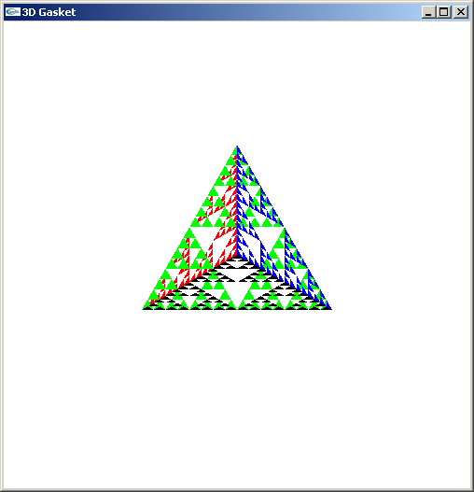
Almost Correct
Because the triangles are drawn in the order they are defined in the program, the front triangles are not always rendered in front of triangles behind them
get this
want this

Slide 20
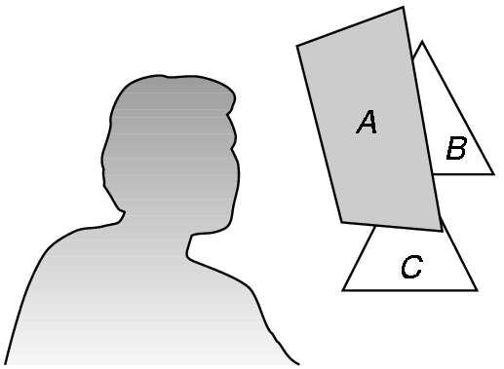
Hidden-Surface Removal
We want to see only those surfaces in front of other surfaces
OpenGL uses a hidden-surface method called the z-buffer algorithm that saves depth information as objects are rendered so that only the front objects appear in the image

Slide 21
Using the z-buffer algorithm
The algorithm uses an extra buffer, the z-buffer, to store depth information as geometry travels down the pipeline
It must be
Requested in main.c
glutInitDisplayMode
(GLUT_SINGLE | GLUT_RGB | GLUT_DEPTH)
Enabled in init.c
glEnable(GL_DEPTH_TEST)
Cleared in the display callback
glClear(GL_COLOR_BUFFER_BIT |
GL_DEPTH_BUFFER_BIT)

Slide 22
Surface vs Volume Subdvision
In our example, we divided the surface of each face
We could also divide the volume using the same midpoints
The midpoints define four smaller tetrahedrons, one for each vertex
Keeping only these tetrahedrons removes a volume in the middle
See text for code

Slide 23
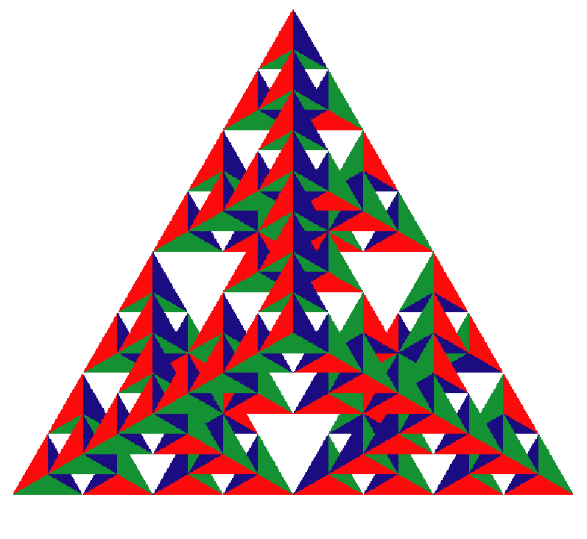
Volume Subdivision

